Slide 1
Easy Law
Making laws accessible to all

Slide 2
Problem Statement
There are more than a 1000 laws in our country. A number of them affect us directly or indirectly. It doesn’t take a few moves to realize that we might be on the wrong side of the law. A common man has little knowledge about these, most times, complicated laws. This in turn leads to a lack of awareness among the general public. It can be as simple as the documents that are needed to be carried while driving, or a land dispute and legal actions.
The lack of awareness of laws prove costly to most of us, as challans, fines, and even the fee for a lawyer.
The availability of these laws in a simplified manner would ease a lot of doubts people of India have.

Slide 3
Our Solution

Slide 4
Easy law helps people to keep track of legislature
Can look up laws regarding a state or a department
Laws are described in simple language
Laws regarding common departments are easily accessible from home page
Chat bot supported that fetches laws related to the query and presents in simple language.

Slide 5
Architecture

Slide 6
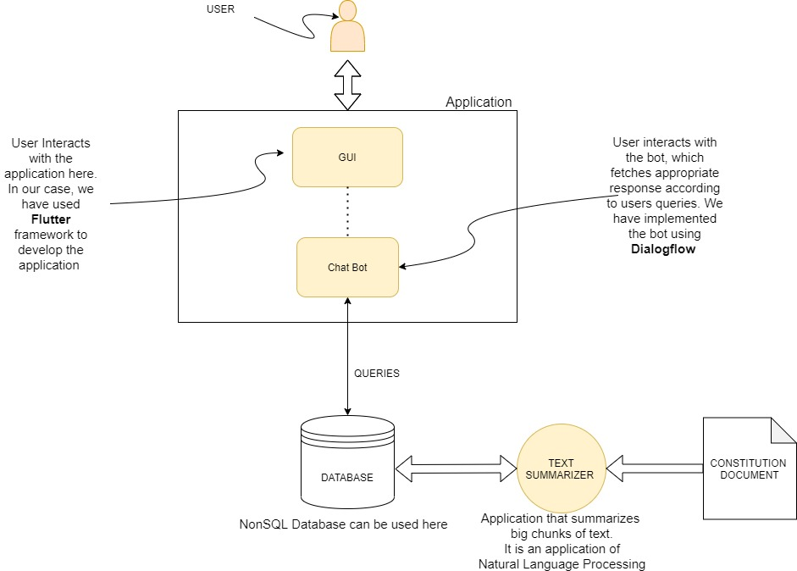

Slide 7
Application flow

Slide 8
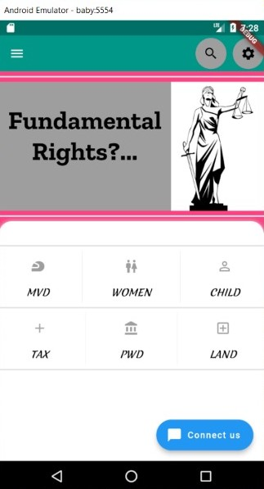
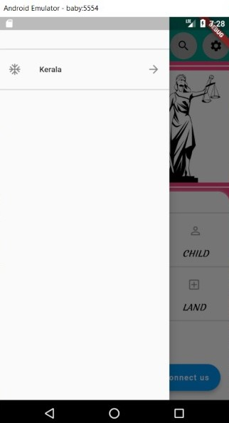
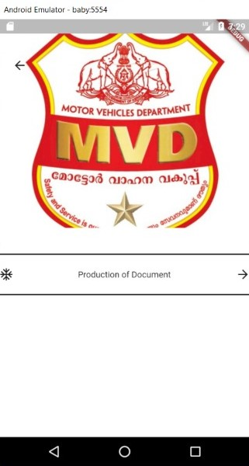
Displays the laws related to departments frequented by common people for easy access
Chat bot gives access to more laws.
Laws are categorized by different states and Union Territories to suit each of them
Lists the laws regarding the particular department

Slide 9
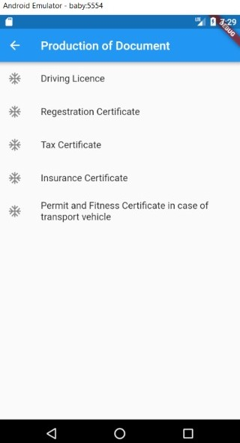
Laws are listed such that they are easily understandable

Slide 10
Demo

Slide 11
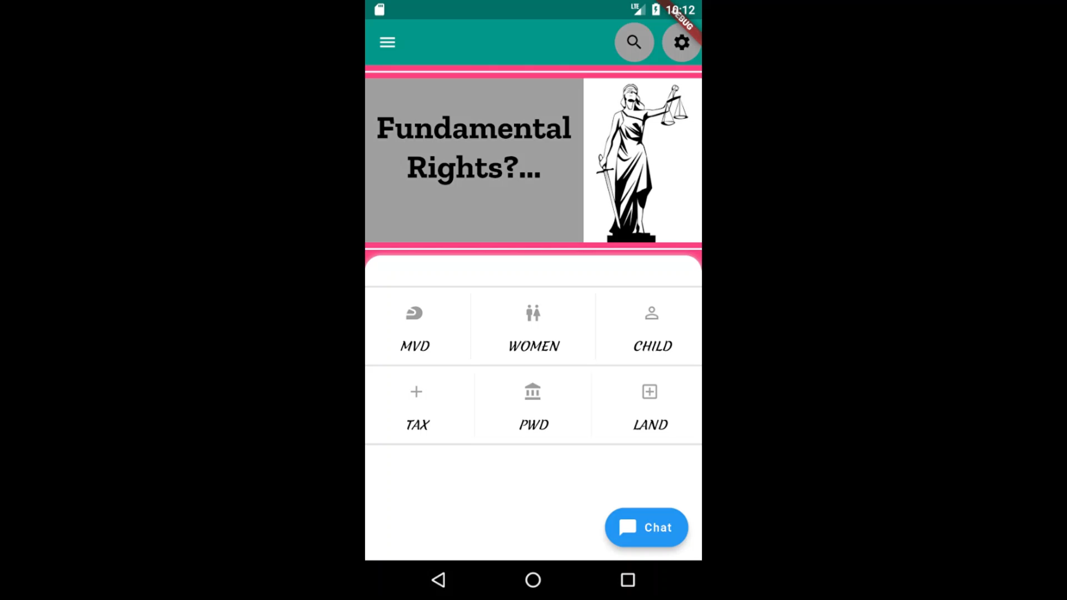

Slide 12
Questions?

Slide 13
Presented By: Muhammed Sajad A Sidharth PB Shruti Santosh

